Slide 1
High-Speed Microscopic Imaging of the Initial Stage of Diesel Spray Formation and Primary Breakup
C. Crua, T. Shoba, M. Heikal, University of Brighton
M. Gold, C. Higham, BP Global Fuels Technology

Slide 2
Research objectives
Improve understanding of:
Initial stage of diesel spray formation
Breakup mechanisms of jet and ligaments

Slide 3
Optical diagnostic technique
Techniques considered:
High-speed video → Resolution too coarse
Doppler anemometry → Slow; Dispersed spherical droplets only
Long-range microscopic imaging → Lighting is difficult

Slide 4
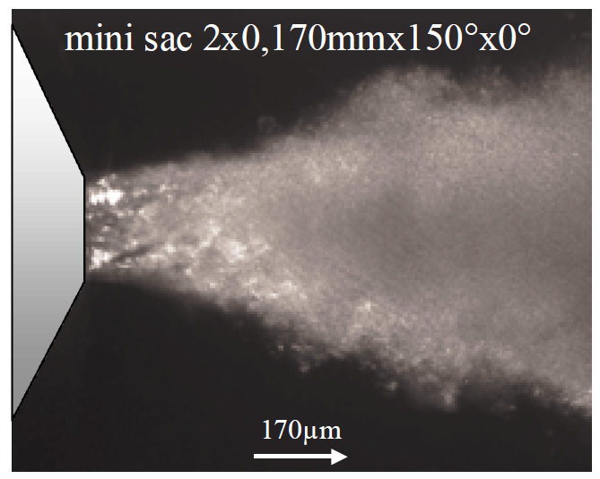
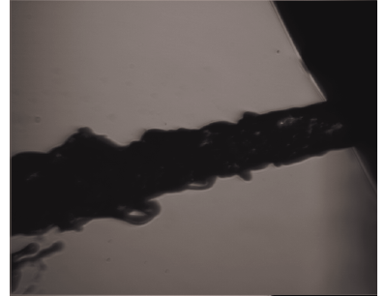
Microscopic imaging of diesel sprays
Badock, Wirth, Fath, Leipertz (1999)
Heimgärtner , Leipertz (2000)
Bae, Kang (2005)
Roisman, Araneo, Tropea (2007)

Slide 5
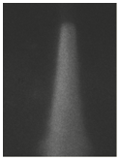
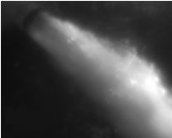
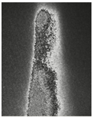
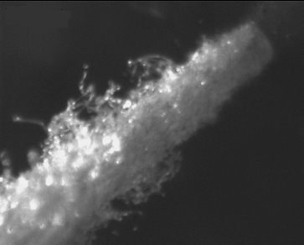
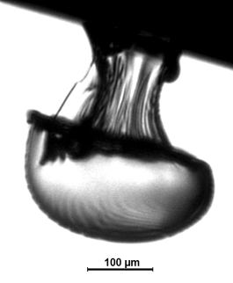
Technique development
Flood light
Spark light
(~ 500 ns)
Pulsed laser
(~ 6 ns)
Laser + diffuser
(~ 20ns)
Flood lights: Motion blurring, not enough light
Spark light: Short exposure but still some motion blurring
Pulsed laser: Short exposure but speckling artefact
Pulsed laser + diffuser: Non-homogeneous scattering
Pulsed laser + diffuser + shadowgraphy: Correct exposure

Slide 6
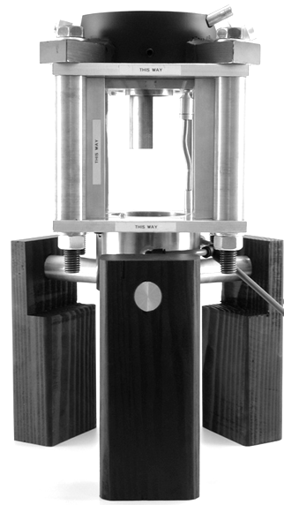
Non-evaporative test conditions
Static diesel spray rig
Ambient pressure & temperature
Quiescent air motion
Allows to develop experiments off engine

Slide 7
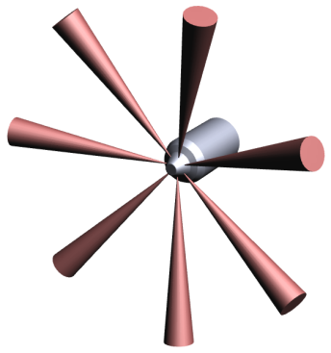
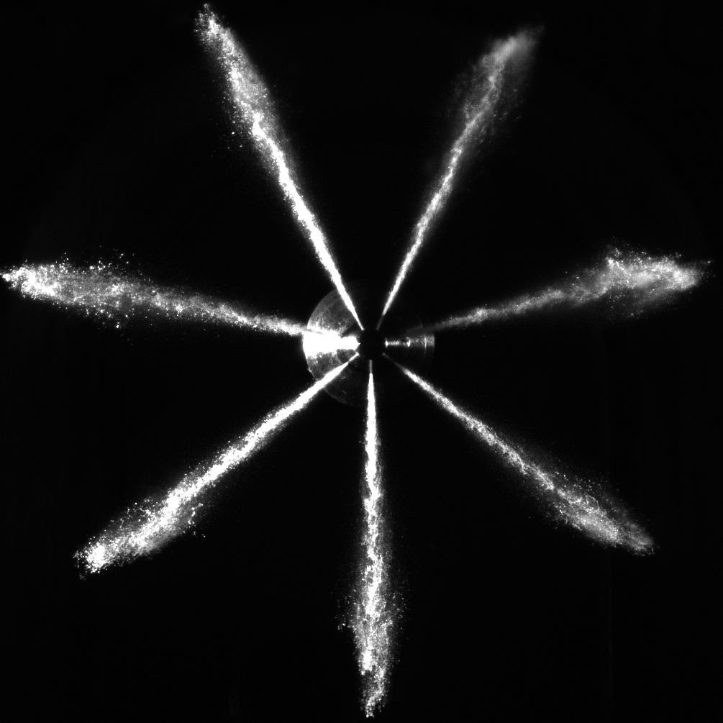
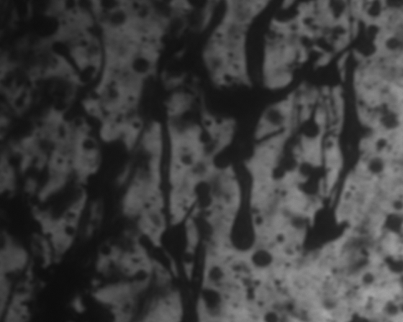
Simultaneous micro & macroscopic imaging
Light source
Microscope
Camera
Camera

Slide 8
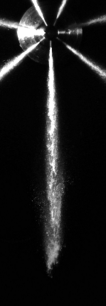
Spray microscopy test conditions
Field of view: 768 x 614 µm (1280 x 1024 pixels)
Injection pressures: 400, 1000, 1600 bar
Ambient pressure: atm
Spatial locations: 0 to 5 mm in 0.5 mm increments
6 to 30 mm in 4 mm increments

Slide 9
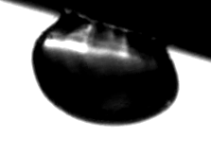
Initial stage of diesel spray formation
135 µm
Spheroidal cap
Surface ripples
Stagnation point
Spheroidal cap
VCO Delphi DFI1.3, Pinj = 400 bar, ICP = 1 atm, exp = 20ns, 0.600 µm/pix

Slide 10
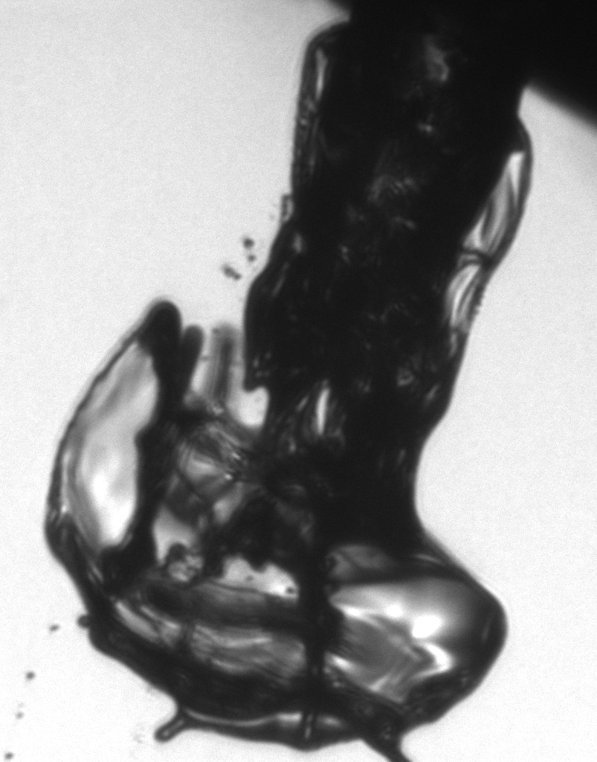
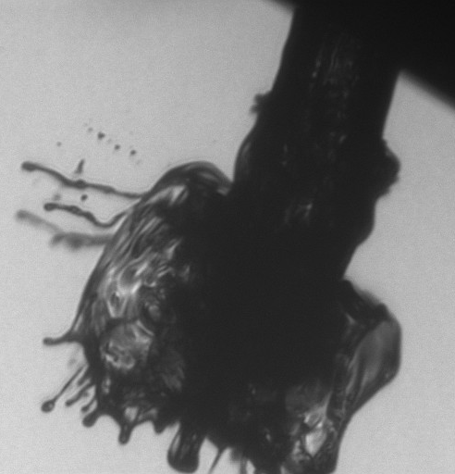
Initial stage of diesel spray formation
Pinj = 400 bar, ICP = 1 atm, exp = 20ns, 0.600 µm/pix

Slide 11
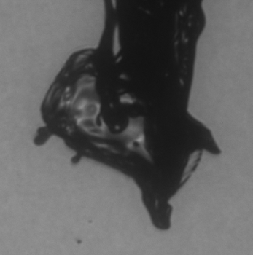
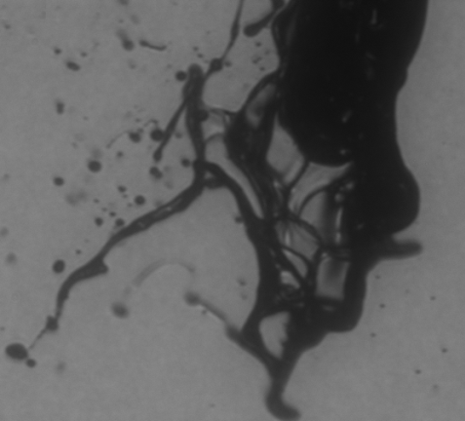
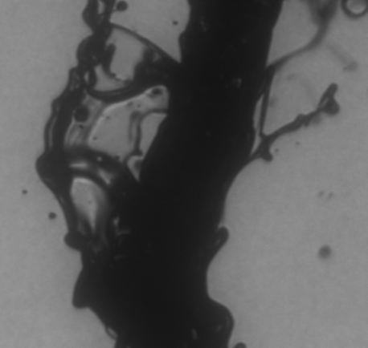
Ligament formation and primary breakup 0.5 – 1.0 mm from nozzle
Pinj = 400 bar, ICP = 1 atm, exp = 20ns, 0.600 µm/pix

Slide 12
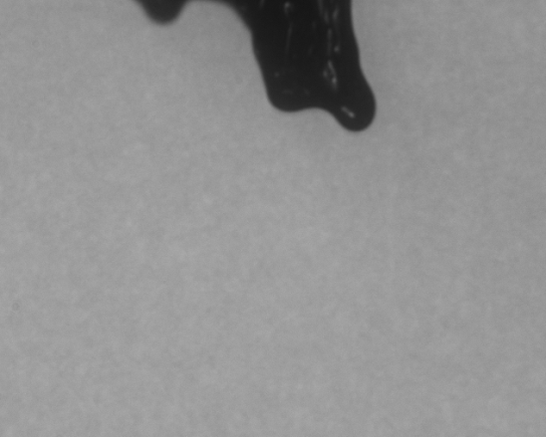
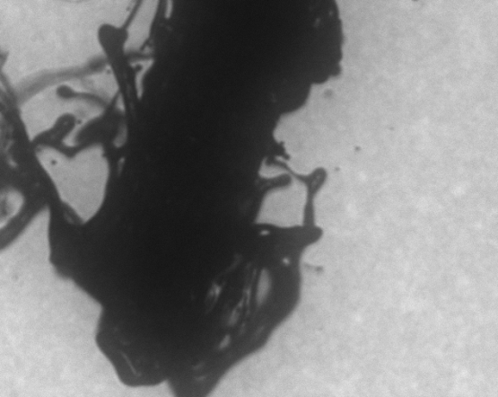
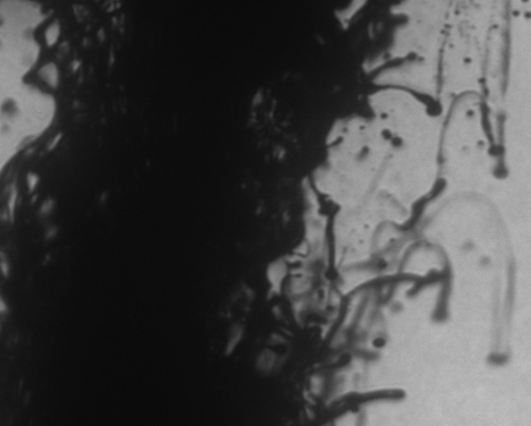
Ligament formation and primary breakup 1.0 – 1.5 mm from nozzle
Pinj = 400 bar, ICP = 1 atm, exp = 20ns, 0.600 µm/pix

Slide 13
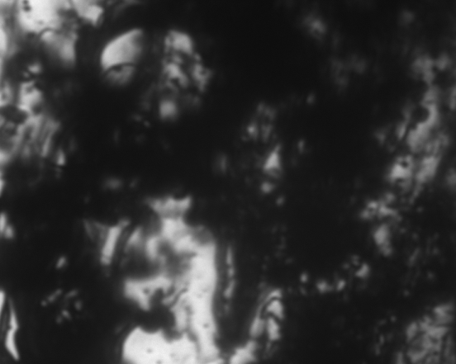
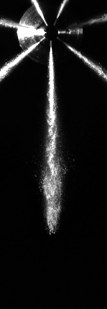
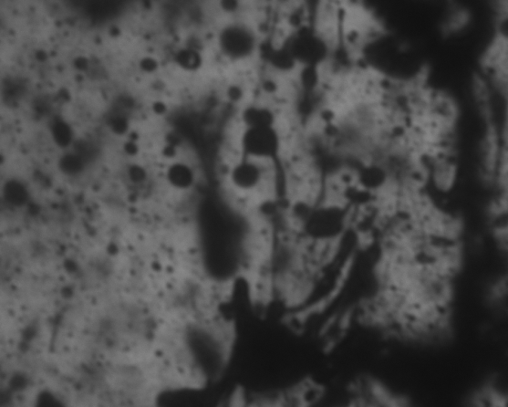
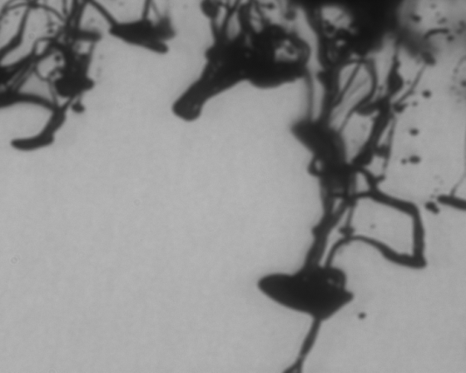
18.5mm downstream
200µs later

Slide 14
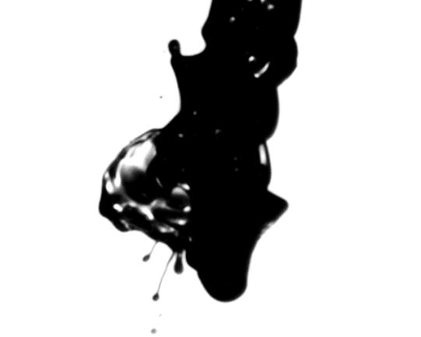
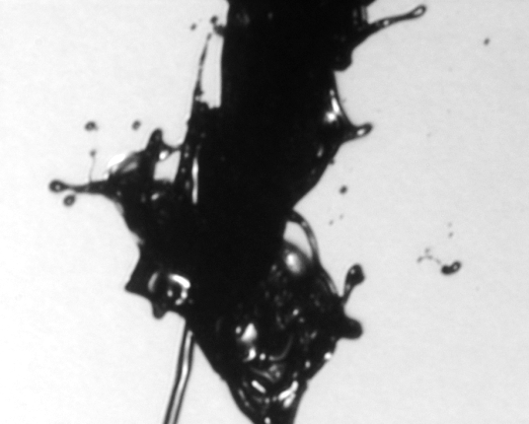
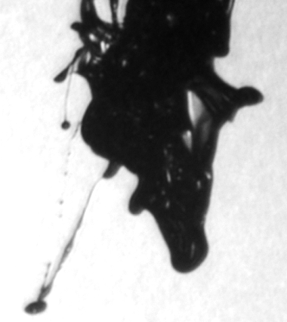
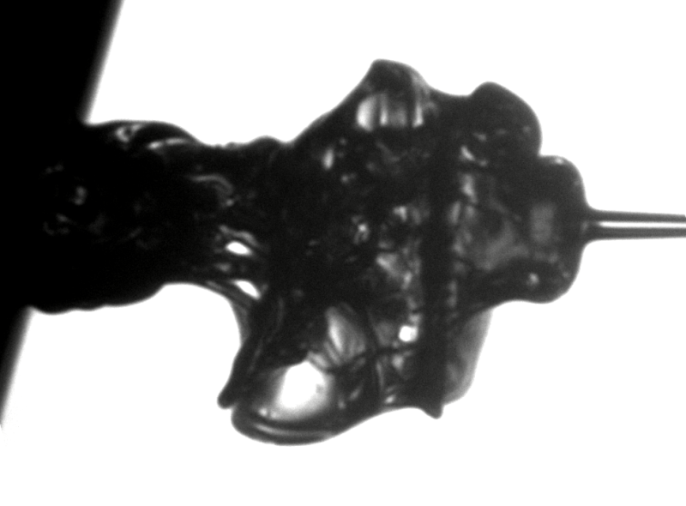
Ligaments ahead of the jet
Roisman, Araneo, Tropea (2007)

Slide 15
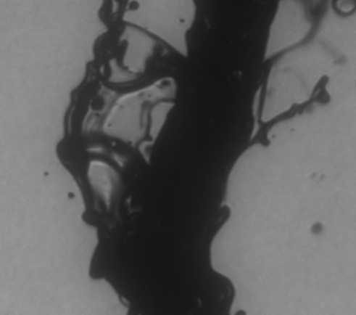
Questions arising
Temporal evolution of initial jet?
Origin of ligaments ahead of jet?
Breakup mechanisms within initial 1 mm?

Slide 16
Ultra high-speed micro & macroscopic video
Light source
Microscope
u-HS camera
HS camera
200 million fps, 5ns exp,
1280x960 pixels
16 frames, intensified
100k fps, 1µs exp,
200x60 pixels
Non-intensified

Slide 17
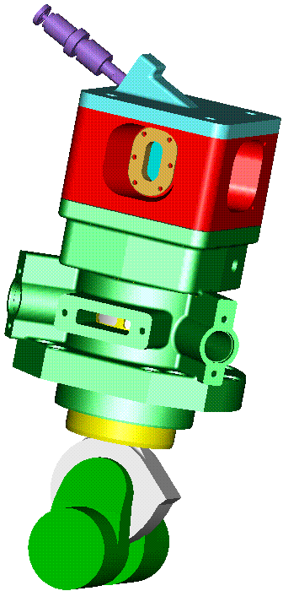
Evaporative test conditions
Rapid Compression Machine – Ricardo Proteus
4, 6, 8 MPa pressure at TDC
Up to 200 MPa fuel injection pressure
540 K estimated temperature at TDC
Operated at 500 rpm
Quiescent air motion at start of injection (no swirl)
Notes:
Independent control of air pressure and temperature
Multiple consecutive injections of fuel
Wide selection of single/multi hole nozzles
Custom controller designed to allow flexible control of injection pressure, timing and duration

Slide 18
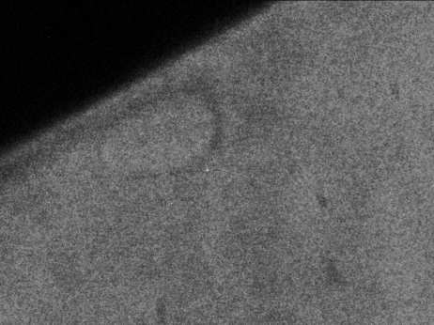
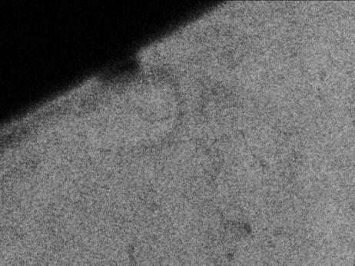
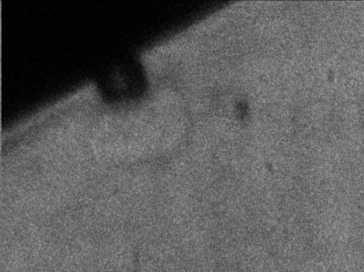
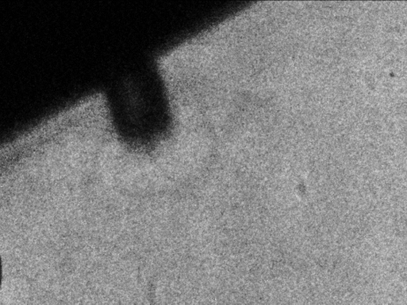
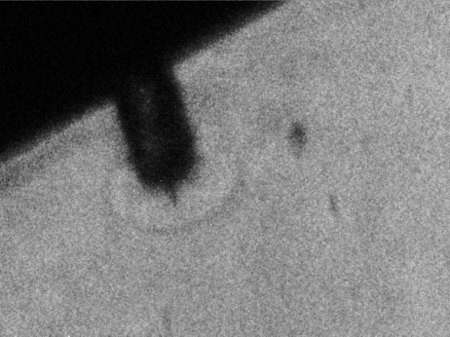
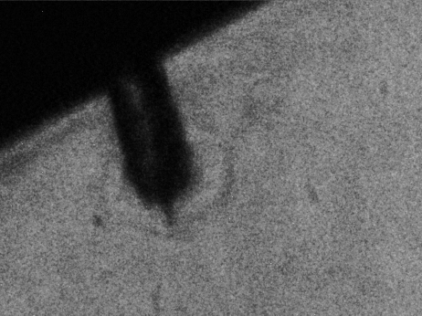
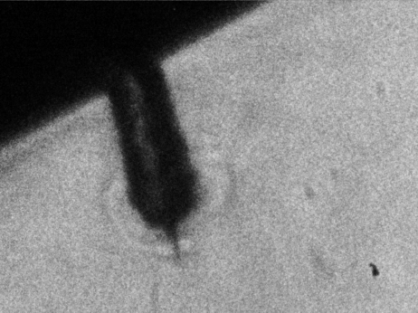
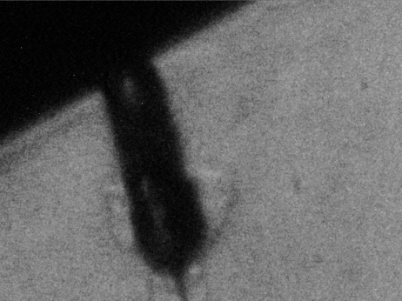
Central ligament ahead of the spray
995 µm
746 µm
Spheroidal cap is translucent → Vapour phase → Residual fuel
Jet and central ligament are opaque → Liquid phase → Fresh fuel
Ligament penetrates faster than jet → Less resistance along centreline
Pinj = 400 bar, ICP = 40 bar, exp = 20ns, dt = 2µs, 0.777 µm/pix

Slide 19
Central ligament ahead of the spray
995 µm
746 µm
Pinj = 400 bar, ICP = 40 bar, exp = 20ns, dt = 2µs, 0.777 µm/pix

Slide 20
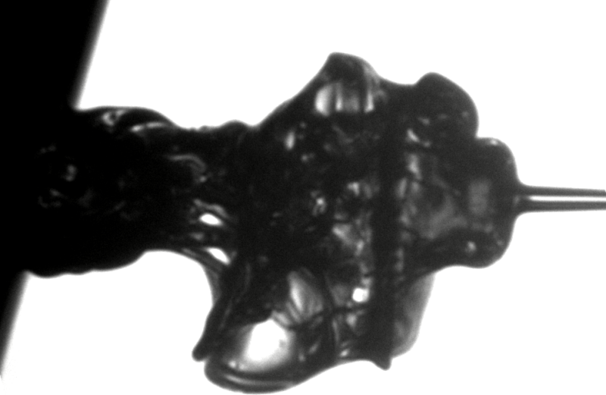
Ligaments ahead of the spray
D = 135 µm
Spheroidal cap
(residual fuel)
Corolla
Trapped fuel pushed out by fresh fuel
Less resistance along centreline
→ Vortex ring motion
Surface ripples
→ shear layer
∅127 µm
~D
Jet (fresh fuel)
∅23 µm
Ligament

Slide 21
Effect of spheroidal cap on jet velocity
Jet without cap
22 m/s
36 m/s
Jet: 44 m/s
Cap: 14 m/s
Pinj = 400 bar, ICP = 80 bar, exp = 40ns, dt = 2µs, 0.777 µm/pix

Slide 22
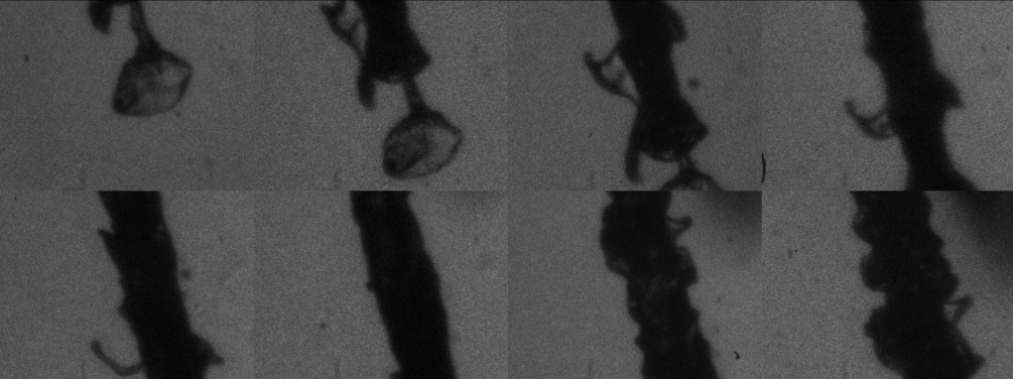
Breakup mechanisms within initial 1 mm
Instability
Sheet
Ligament
Droplets
Pinj = 400 bar, ICP = 1 atm, exp = 40ns, dt = 5µs, 0.777µm/pix

Slide 23
Breakup mechanisms within initial 1 mm
Instability
Sheet
Ligament
Droplets
Pinj = 400 bar, ICP = 1 atm, exp = 20ns, 0.600µm/pix

Slide 24
Further developments
Ultra-high speed drop size & velocity?
Need: - Higher resolution (non-intensified) images
- Higher magnification factor

Slide 25
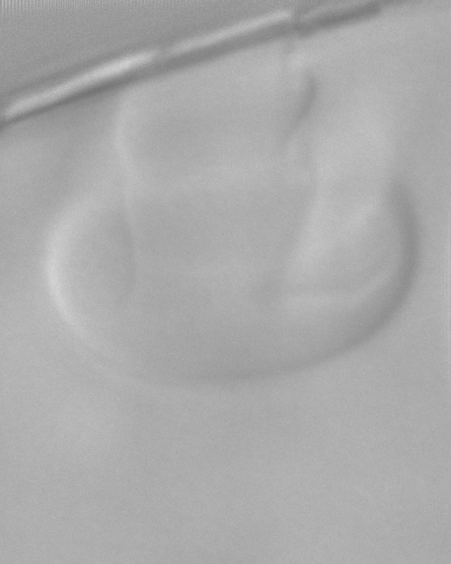
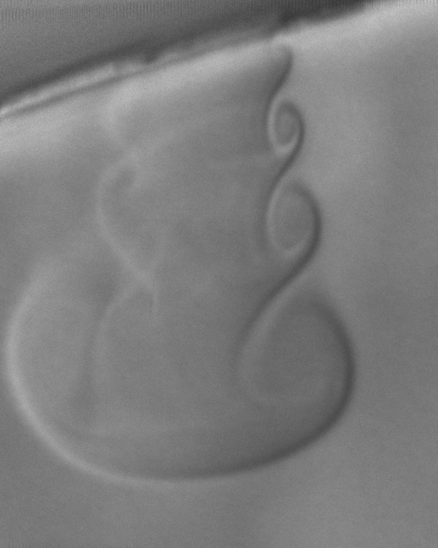
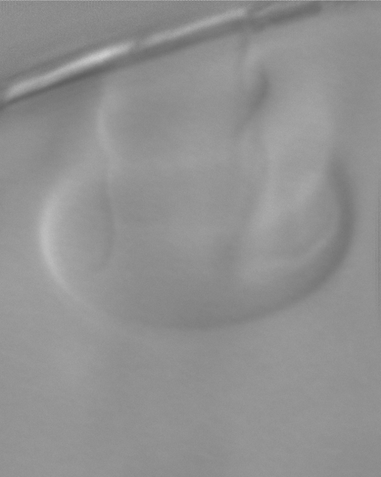
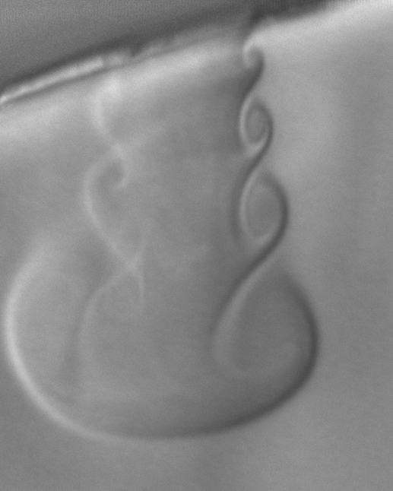
Double-shot microscopic imaging samples
337 µm
446 µm
Confirms vortex ring motion in the vaporised fuel
VCO, Pinj = 400 bar, ICP = 40 bar, exp = 20ns, dt = 0.5µs, 324nm/pix

Slide 26
Double-shot microscopic imaging samples
337 µm
446 µm
Vaporised trapped fuel with sac-type Delphi DFI 1.5, 1000 bar
Pinj = 1000 bar, ICP = 40 bar, exp = 20ns, dt = 0.5µs, 324nm/pix

Slide 27
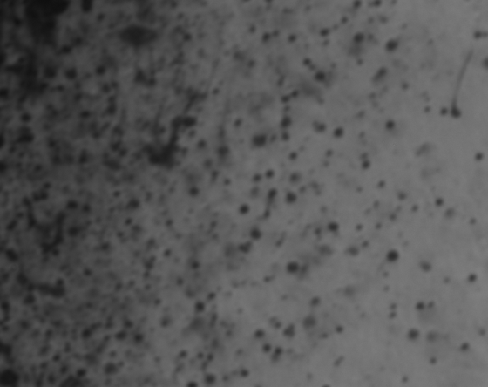
Next step: Droplet sizing
10.5 – 11.0mm
18.5 – 19.0mm
Spray periphery
Spray centre
Spray centre
Spherical droplets represent a small proportion of fuel volume

Slide 28
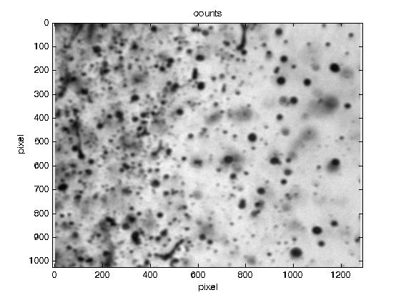
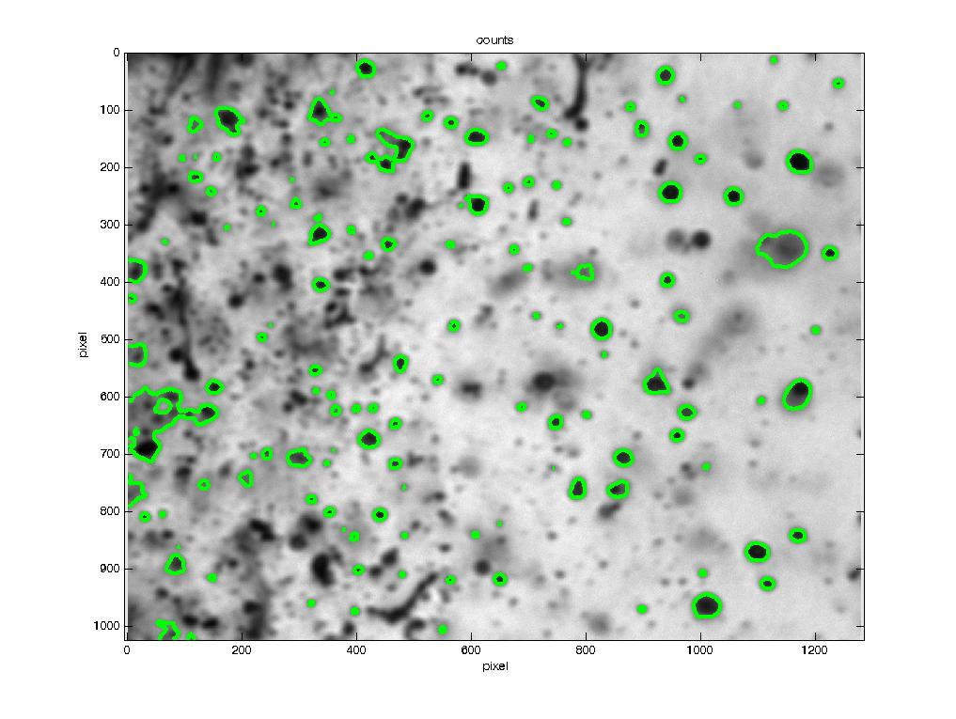
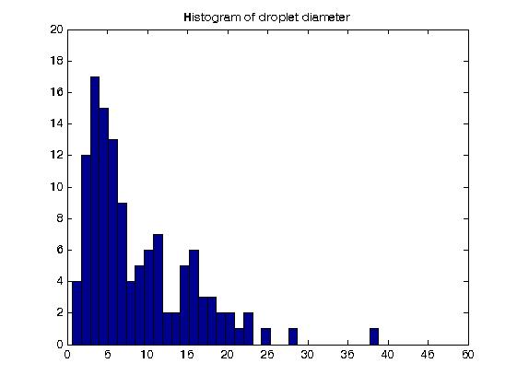
Next step: Droplet sizing
Further work:
Particle tracking for single droplet velocity and size

Slide 29
Conclusions
Spray formation
Residual fuel remains in the nozzle orifice between injections
(VCO and sac-type nozzles, latest injector generation)
Trapped fuel affects the dynamics of spray formation
(evaporative and non-evaporative conditions)
Degradation of residual fuel → internal deposit
Breakup mechanisms
Breakup processes observed & described near nozzle
Spherical droplets represent a small proportion of total fuel volume
(need techniques for aspherical droplet sizing and velocimetry)

Slide 30
High-Speed Microscopic Imaging of the Initial Stage of Diesel Spray Formation and Primary Breakup
C. Crua, T. Shoba, M. Heikal, University of Brighton
M. Gold, C. Higham, BP Global Fuels Technology

